Slide 1

An overview of the Foundation® Simulation
Introduction
Unforgettable Business Learning

Slide 2

Why Simulate?
View Alternative Strategies
Risk-Free
Compresses Time
(1 Round=1Year)
Enjoyable
Selectivity <=> Integration

Slide 3

Objectives of the Capstone Simulation
Demonstrate effectiveness of multi-discipline teams working together.
Use strategic thinking.
Test your business acumen.
Understand overall interaction and impact of various parts of a business on one another.
Grow the awareness of competition.
Take away practical skills in business management.

Slide 4
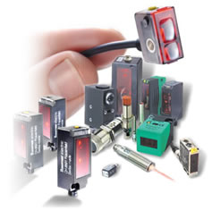

Industry Overview
Unforgettable Business Learning
© 2012 Capsim Management Simulations, Inc.
Unforgettable Business Learning

Slide 5

The Story: Background on Your Company
FTC required Sensors Inc. to be broken up into separate companies:
Andrews
Baldwin
Chester
Digby
Erie
Ferris
Started as a single corporation named Sensors, Inc.
Sold sensors as main product
Corporation was shut down by FTC due to monopolistic operations
Your job: Operate one of the companies and make it successful.

Slide 6

The Start
When Sensor Inc. breaks up, each of the new companies starts off with the following scenario:
$40 Million in Sales
1 Product Line
Closed Marketplace
2 Segments

Slide 7



Sensors: An Overview of Your Company’s Product
Customers (OEMs) need sensors for their products to function.
Used for diverse applications.
Two clear market segments
Low Tech
Customer demands vary between the two segments.
High Tech

Slide 8
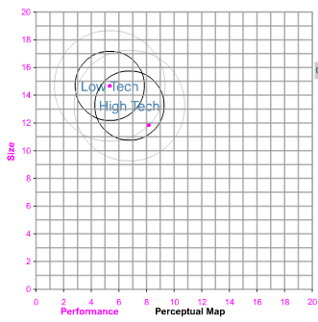
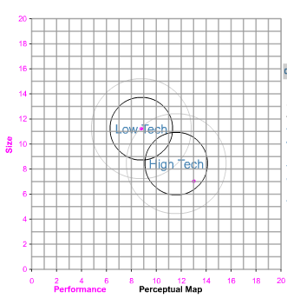
The Marketplace: A Look Into The Segments
Perceptual map used to track changing consumer demands in size and performance
Each year, consumers will expect faster (higher performance) and smaller products (lower size)
This causes the segment circles to drift to the lower right constantly
Market segments continue to diverge over time
*Note the drift towards the lower right (expectations of faster and smaller products). Also note the divergence of the segments.
Round 1 Consumer Segment Expectations
Round 8 Consumer Segment Expectations

Slide 9
Low Tech Consumer Characteristics
Price
Price sensitive. Prefer prices at lowest possible.
Positioning
Prefer less cutting edge products (Bigger Size & Low Performance)
Age
Ideal Age: 3 years
Reliability
Ideal MTBF: 14000-20000
What the customers say
I want to spend as little money as possible!
I want them to have been around for a while…no beta testing!
They have to be moderately reliable…but not enough to drive up the price!
The technology doesn’t have to be cutting edge.

Slide 10
High Tech Consumer Characteristics
Price
Not price sensitive, willing to pay higher prices.
Positioning
Needs Smaller and Faster Sensors
Age
Ideal Age: 0 years
Reliability
Ideal MTBF: 17000-23000
What the customers say
Price is not an issue. I want the best sensors in the market!
I want the newest sensors you have!
We need the total package. High performance and small sensors for our products.
Only the most cutting edge products will cut it!

Slide 11

Segment Growth
According to a Market Analyst, there will be continuous growth in the sensor market.
I see the entire market growing at around 14% or 15% per year. The high tech market alone will be growing at a whopping 16%.
Your goal: Prepare your company’s products to meet the needs of the growing market.
Unforgettable Business Learning

Slide 12

The Decision Making Process
Unforgettable Business Learning
Unforgettable Business Learning

Slide 13
Decision Areas
Students need to coordinate strategy and tactics across the following areas of their company:
R&D
Marketing
Production
Finance
Additional Modules
HR
TQM

Slide 14

R&D
Ensure the perceived age of the product meets customer demands
Build the quality and reliability (MTBF) of the products
Invent new products to address the changing marketplace and take advantage of new opportunities
Determine the specifications of the products to meet customer expectations

Slide 15

Marketing
Set the price of your products
Build customer awareness through investing in promotion
Establish a sales force and distribution channels
Set the sales forecast for your products
Set Credit Policies
(A/R and A/P)

Slide 16

Production
Purchase machinery to automate your facilities
Buy or sell capacity on your product lines
Set production schedule
Manage the majority of the company’s fixed assets
Staff your facility with workers

Slide 17

Finance
Acquire capital to fund growth and operations
Issue Stock
Short-Term Debt
Issue Long-Term Bonds
Issue dividends to your shareholders
Balance your debt portfolio
Manage your Proformas

Slide 18

Proformas: A Look Into the Future
Proformas use decisions made in the current year to project company performance for the next year
Analyzing them is critical for company success
The following proformas are available:
Balance Sheet
Income Statement
Cash Flow Statement
Financial Ratios
Balanced Scorecard
Unforgettable Business Learning

Slide 19

Scoring Methods
Unforgettable Business Learning
Unforgettable Business Learning

Slide 20
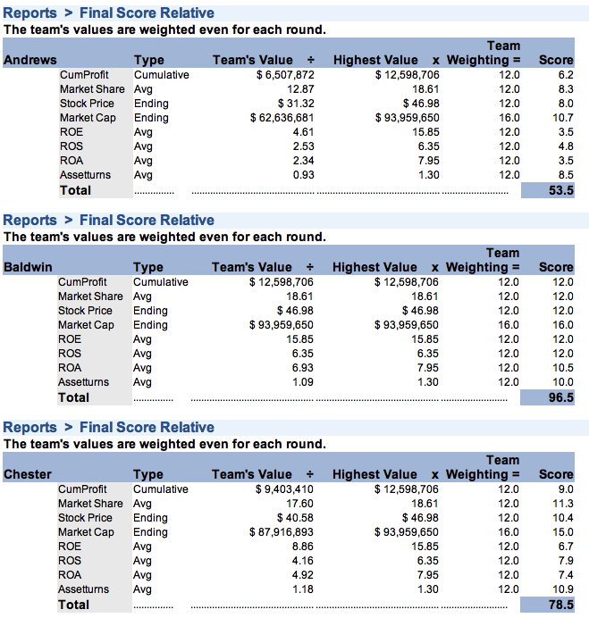
Success Measures
Success Measures
  In the real world, companies have different goals. Using the same success measures, YOU get to choose the parameters on which your company is measured.
  Some of the Criteria that are used:
    Cumulative Profits
    Average Market Share
    Average ROS (Return on Sales)
    Average Asset Turnover
    Average ROA (Return on Assets)
    Average ROE (Return on Equity)
    Ending Stock Price
    Ending Market Cap
  You or the professor choose the percentage weighting for each selection.

Slide 21
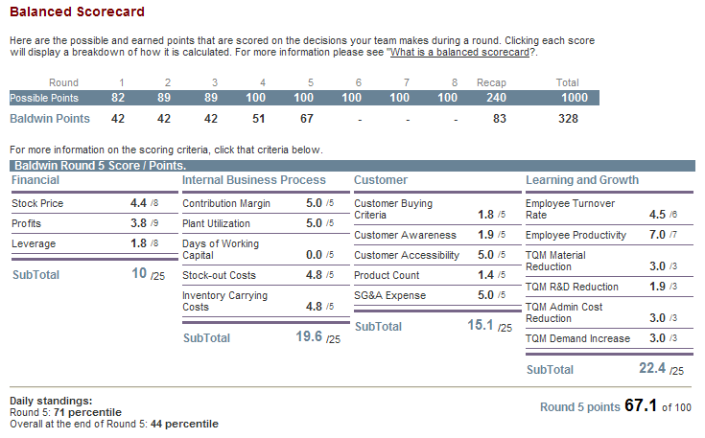
Balanced Scorecard
Balanced Scorecard
  Improving company financial picture in preparation for final debrief
  Point System
  Gauges company performance based on four perspectives
    The Customer
    Internal Business Process
    Innovation and Learning
    Financials
  In the simulation, a Proforma Balanced Scorecard is available to project results for the upcoming year.

Slide 22
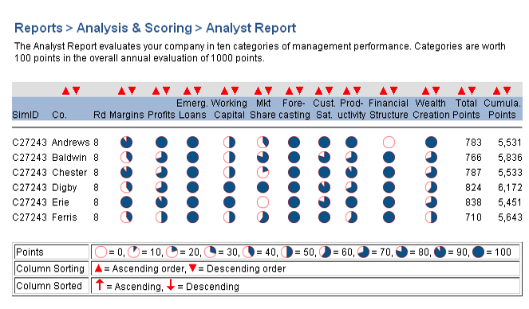
Analyst Report
Analyst Report
  Evaluates your company in ten categories:
    Margins
    Profits
    Emergency Loans
    Working Capital
    Market Share
    Forecasting
    Customer Satisfaction
    Productivity
    Financial Structure
    Wealth Creation

Slide 23
Things to do on an Annual Basis
Establish business strategy for your company
Analyze Foundation FastTrack to see industry results
Make tactical decisions across each functional area (aligned to strategy!)
Upload official decisions and confirm on the website
Await results when Professor processes
Rejoice in your superior capitalistic acumen
Begin the process again by confirming alignment of your results with your company’s strategic goal.
Unforgettable Business Learning
Unforgettable Business Learning

Slide 24
Good Luck and Enjoy!
Unforgettable Business Learning
Unforgettable Business Learning

